Slide 1



Perform Clerical Procedures
Unit Code:
D1.HRS.CL1.11 D1.HOT.CL1.05 D2.TCC.CL1.09
Notes:
Trainer to introduce purpose and content of unit.

Slide 2
Unit descriptor
This unit deals with the skills and knowledge required to perform clerical procedures in a range of settings within the hotel and travel industries workplace context.
Element 1: Process office documents
Element 2: Draft correspondence
Element 3: Maintain document systems
Notes:
Class room requirements: this unit can be only be delivered in
a computer room
with an interactive whiteboard or data projector.

Slide 3

Assessments
For this unit, you must complete:
5 work projects to be graded
Multiple class demonstrations by trainer, followed by class practice.
Notes:
Explain to trainees the 5 work projects are due by a date agreed to by you, the trainer, and graded.

Slide 4
Background
This unit also contains
Glossary – background information only
Background notes – read this at home (marked )
Notes:
Trainer to hand out TM
Trainer to show glossary and background notes in Trainee Manual.

Slide 5
Element 1: Process office documents
In this section, you will learn how to…
Process documents with appropriate office equipment in accordance with enterprise procedures and within designated timelines
Identify and rectify and/or report malfunctions promptly in accordance with enterprise procedures
Use office equipment to process documents.
Notes:
Ask trainees: Who has relevant work experience in terms of use of use of office equipment, writing correspondence, filing, etc.?

Slide 6
Hospitality office duties
Recording receipt or sending of documents
Mailing (including bulk mailing)
Photocopying
Faxing
E-mailing
Collating and binding
Banking
Contd.
Notes:
Discuss office duties. Can you think of any more not listed here?

Slide 7
Hospitality office documents
Guest mail
Customer records
Incoming and outgoing correspondence, letters, facsimiles, memos, reports
Menus
Banquet orders
Financial records, invoices, and receipts.
Always follow industry guidelines
Notes:
Ask trainees for their experience in industry guidelines in their workplace.
Link it to your own
Bring in some samples.
Ask students to bring in non-sensitive correspondence or office documentation to show consistency across the board.

Slide 8

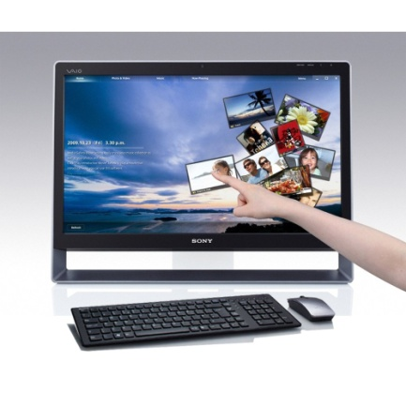
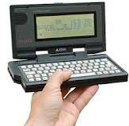
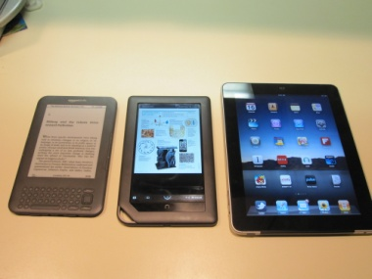
Different types of computers
Notebook or Laptop
Touch Screen PC
Palmtops
Tablets/I pads and I phones.
Notes:
Trainer to explain types of computers and his/her own experience.
Notebook or Laptop
These are portable computers which are used by people “on the go”. A notebook is similar in size to a standard book. A laptop is larger than a notebook. They are both lightweight, very convenient but are not as fast as a fixed PC, have a shorter battery life and can easily be damaged if not taken care of.
Touch Screen PC
This is a PC that can be held in the hand. A touch screen looks similar to a notebook/laptop monitor, though they can vary in style. A special pen is used to access different menu options on the touch screen. There is no keyboard or mouse.
Palmtops
Mini computers are designed to perform basic computer functions and fit in the palm of the hand. Many are used in conjunction with a normal PC. There are different styles available. Two common types are shown. You can transfer data from your PC to the Palmtop as reference or to edit on the go. The palmtop is not as powerful as a PC. Palmtops can be connected to the internet, or to a PC and are useful when travelling to send and receive email.
Tablets/I pads and I phones
IPads and android tablets are a combination of a modern smart phone and a laptop computer. Business owners often use tablets to get tasks done on the run, create presentations for meetings and update websites and blogs. They are lightweight, compact and affordable. They can easily be synchronised with your computer when returning to the office.

Slide 9
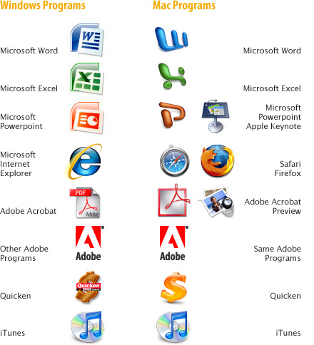
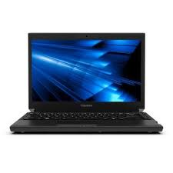

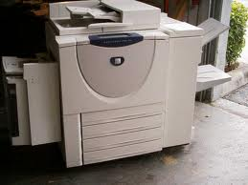

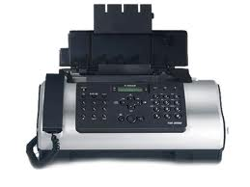
Hardware versus software
Notes:
Trainer to explain
Hardware
The physical components of a computer system - everything that you can touch - are called hardware.
Software
The programs used on a computer are called software. This includes system software (such as Windows, Mac OS etc.) and application software such as Microsoft Word, Microsoft Excel, etc. System software is necessary in order to run a computer and all applications within it.

Slide 10





Office hardware
Computers, including laptops
Digital cameras
Zip drives
Modems
Printer/scanner/photocopier combination
Facsimile
Paging equipment
Calculators
Audio-transcribing machine
Telephone answering machines
External hard drives
Ergonomical mouse.
Notes:
Discuss office hardware. Can you think of any more not listed here?

Slide 11


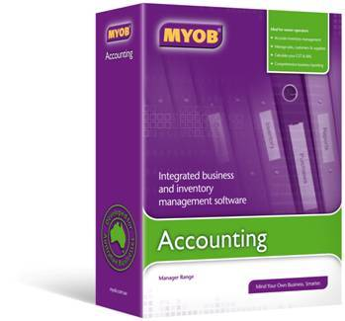


Office software
Email and internet browsers
Word processing
Spreadsheets
Databases
Work project
Accounting packages
Presentation packages.
Notes:
Trainer to explain the internet browsers available in their country (e.g. Internet Explorer, Mozilla Firefox) and ask what trainees use at work and at home.
Trainer to ask what software trainees use to do word processing: Word for Windows? Or do they use Apple Mac and download Word onto it? Trainer to explain there are different versions of Word e.g. 2003, 2007, 2010
Trainer to ask what spreadsheets trainees use (eg Excel) and what they feel is good/not as good about it. Do they know how to sort it? Enter formulas?
Trainer to explain that engineers, for example, use a project management tool called Microsoft Project which allows them to track projects
Trainer to explain that there are various packages to do accounting/bookkeeping such as MYOB, Quicken
Trainer to explain that he/she uses Power Point – trainer to explain its advantages for presentations.

Slide 12

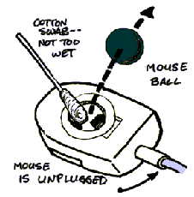
Maintenance
Preventative maintenance
Cleaning of your keyboard, monitor and mouse
Clearing paper jams, changing cartridges and cleaning the printer
Routine maintenance
Use a damp cloth or other approved cleaning materials.
Notes:
Explain how this works and link it to your own experience e.g. When I am at the workplace, the procedure for routine maintenance is…. Or, the procedure for ordering Consumables is…..
Demonstrate how to do it: turn the keyboard upside down and gently tap the bottom of the keyboard. Show trainees how to clean monitors with a damp cloth. Demonstrate how you open the mouse, remove the panel, and clean the tracking ball and the rollers inside the mouse.
Ask trainees what their workplace experience is in relation to ordering new consumables and organising maintenance? Do they have to use a log? Did they get training on how to deal with this?

Slide 13

Technology consumables
Printer ribbons and cartridges
Cd ROMs
Toner cartridges
Back-up tapes.
Notes:
Trainer to bring in some consumables such as per picture.

Slide 14
Work project 1.1 to 1.3
In pairs, you are to set up a new office for an Adventure Tourism Company in Bangkok. Give the company a name. Your company will have 4 employees which will consist of one Director, one Operations Manager, one Operations Assistant and one Marketing Coordinator. Your office will be in an office building, within the central business district. Create a layout which reflects the needs of these 4 employees.
Research needs to be undertaken, taking into consideration business technology that you would require including hardware and software, as well as ergonomics.
Notes:
Trainer is to read the work project to trainees. Explain there are two separate parts: one written, one oral presentation in pairs. Set a due date for this project to be handed in,
mark and return the projects to trainees
This is project 1 of 5.

Slide 15
Part A: Written report
You are to provide a layout of the office space.
What office equipment, including business technology, would you select for your new company?
List 2 benefits and 2 disadvantages of the equipment chosen.
What is the cost of the equipment? Provide a detailed breakdown.
How would you maintain this equipment? - in-house or outsourced? Explain why you chose in-house or outsourced?
Besides Microsoft Office and Summit Pro, name 2 other software packages you would choose for your office?
List 2 benefits and 2 disadvantages for each of the software packages chosen.
How would you ensure the set up of the office is ergonomic?
Notes:
Trainer to explain the report requirements to trainees and assist them to find resources to help them answer the questions. Trainer may give the trainees the option of working individually, in pairs or in groups.

Slide 16
Part B: PowerPoint presentation
Use the answers from Part A to create a PowerPoint which satisfies the following:
You are to present to the owner of the company, what you believe would be the best layout, furnishing, and equipment (hardware and software) for the new Adventure Tourism Company office. You have to sell the benefits of your choices to the owner.
Notes:
Show trainees attached sample assessment:
Set standard of your expectations
Set due date for part A
Set due date for part B
Consider weight of this assessment.

Slide 17
Part B: PowerPoint presentation
The following must be evident in your PowerPoint presentation:
Master slide – background used on all slides
Text layout – 3 different text or content layouts to be used
Bullets, Tables, Clip art, Charts, Diagrams or Multimedia – use 3 different modes.
Slide animation / transition – used on at least 6 slides
Minimum 10 slides and maximum 20 slides.
Slides have 5 or less points per slide, legible script with appropriate background and appear professional (less is more). What does this mean in terms of presentation?
Consider the overall appearance of the Power Point very carefully
A copy of your Power Point presentation must be submitted in hardcopy (6 slides per page).
Notes:
Show trainees attached sample assessment – set standard of your expectations.
Set due date for part A.
Set due date for part B.
Consider weight of this assessment.

Slide 18
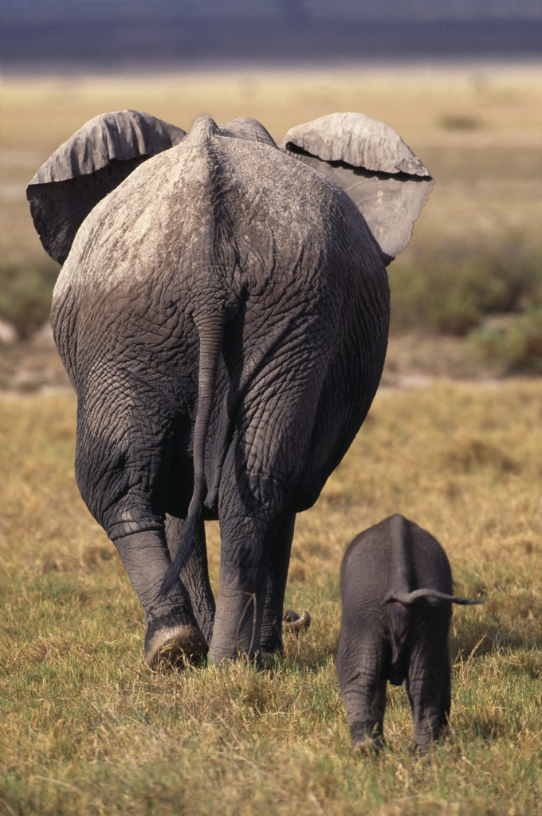
Bangkok Adventure Tourism
Company
By xx & yy
Notes:
Sample opening page.

Slide 19

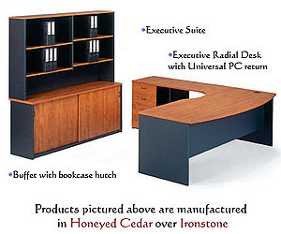
Hardware
 | Desk for all staff Total of package $1,925.00
 | 4 Drawer Filing Cabinet $335.00 Keep the report neatly Find the report easier.
Notes:
Resources and ideas for project.

Slide 20

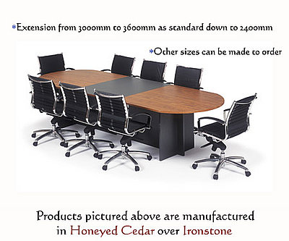
Hardware
 | Chairs $215 Easy to move around and reach things in a short distance area
 | Meeting table $1,020
Notes:
Resources and ideas for project.

Slide 21
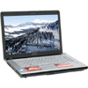
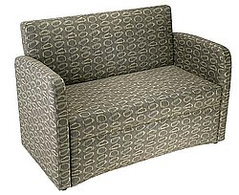
Hardware
 | Laptop for manager $1,299 Can use the computer all the time Compact and easy to use
 | Sofa in reception Area $875
Notes:
Resources and ideas for project.

Slide 22


Hardware
 | Digital Camera $311 Take event photos to do portfolio Record video
 | Projector $1,299 Expand the information to be bigger size
Notes:
Resources and ideas for project.

Slide 23
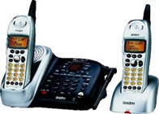

Hardware
 | Desk phone $129 Connecting to customer Making a conference call
 | Computer $788 Collect important information Can upgrade memory
Notes:
Resources and ideas for project.

Slide 24
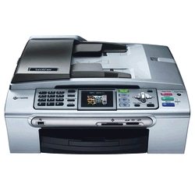
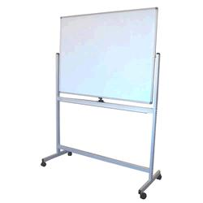
Hardware
 | Fax and scanner $249 Useful Get more space
 | White board $359 All meeting members can understand the same meaning Can move around to everywhere in the company
Notes:
Resources and ideas for project.

Slide 25

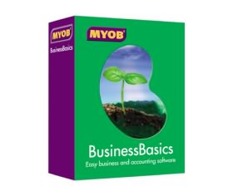
Software
 | Adobe $105-190
 | MYOB $125-158
Notes:
Resources and ideas for project.

Slide 26


Total cost
$18,937
Notes:
Resources and ideas for project.

Slide 27



office layout
Marketing
Coordinator &
Front desk
Meeting Room
Operations Manager
Operations Assistant
Director
Pantry
Notes:
Resources and ideas for project.

Slide 28


Ergonomics Considerations
Follow OH&S procedures
To prevent occupational injuries, rising productivity with worker comfort and morale
Adjustable chairs, natural lights, computer screen with filter, foot-rest.
Notes:
Resources and ideas for project.

Slide 29

Element 1: SUMMARY
Any questions?
Notes:
Ensure trainees have no questions about any of the material covered including acronyms used, difference between hardware and software, consumables, etc.

Slide 30
Element 2: Draft correspondence
In this section, you will learn how to…
Write text using clear and concise language
Ensure text is without spelling, punctuation and/or grammatical errors
Check information for accuracy prior to sending
Notes:
Start section 2:
Return marked assessment – Part A
Ensure trainees are on course with Part B delivery

Slide 31
Type of business documents
Business letter
Minutes
Agenda
Report
Memo/Email
Invoice
Receipt
Message
Notes:
Explain each business document by giving them samples you have brought along to class.

Slide 32
Determine audience and purpose
Who is your audience?
What is your objective?
What do you want them to do with the information?
Are they supposed to read the entire document or just part of it?
Do they need quick points for reference?
Notes:
Discuss the above questions as a whole class.

Slide 33
Research – basic steps
1
2
3
4
5
6
Planning the content of each paragraph
Research: keep reader in mind. Check layout is correct
Collating
Writing
Editing
Presenting.
Notes:
Discuss the basic steps involved in research.

Slide 34
Prepare documents
Basic principles:
Introduction
Body
Summary
Introduce the subject.
One idea only.
All information must be grouped
Chunking: breaking down of info
Summarise all you have said
Action.
Labelling
Integrated graphics.
Notes:
Discuss the basic principles involved in preparing documents.

Slide 35




Online dictionaries/thesauruses
www.dictionary.com
www.thefreedictionary.com
www.thesaurus.com
www.macquariedictionary.com.au
Notes:
Trainer to go online and show trainees online dictionaries.
Ask trainees to look up the words ‘scope, pax, FIT’ in all dictionaries and in the thesaurus. Which one did they prefer? Why? Suggest to bookmark them as a favourite on their computer for future use.

Slide 36

Six steps to good writing
1:
2:
3:
4:
5:
6:
Be clear about your purpose
Plan what you will say
Draft your document
Edit
Type the final draft
Proof read
Notes:
Discuss the six steps to good writing.

Slide 37



Different styles of letters
Modified Block Style Full Block Style Semi block Style
Notes:
Trainer to ask trainees to bring a sample of each different style of letter as above.
Ask trainees which one is which.
Trainer to ask trainees to bring in samples and ask them to identify differences.

Slide 38
Different styles of letters
Modified Block Style
Sender’s address is blocked to the right margin.
Date is in line with the sender’s address
Recipient’s address and the salutation are placed against the left-hand margin
The complimentary close and signature blocks are centred in line with the writer’s address and the date.
Each paragraph is blocked against the left-hand margin
More conservative style of layout.
Notes:
Trainer to ask trainees to bring a sample of each different style of letter as above.
Ask trainees which one is which.
Trainer to ask trainees to bring in samples and ask them to identify differences.

Slide 39
Different styles of letters
Full block style
Attractive and modern layout that is easy to read.
Each part of the letter is placed against the left-hand margin of the page (the sender’s address, the date, the inside address and the salutations).
Supplementary parts such as enclosures, file numbers and copy notations are also blocked.
Notes:
Trainer to ask trainees to bring a sample of each different style of letter as above.
Ask trainees which one is which.
Trainer to ask trainees to bring in samples and ask them to identify differences.

Slide 40
Different styles of letters
Semi block style
This is the most conservative of the three layouts.
Uses the same layout as Modified Block Style, except that the first line of each paragraph is indented from the left-hand margin.
Notes:
Trainer to ask trainees to bring a sample of each different style of letter as above.
Ask trainees which one is which.
Trainer to ask trainees to bring in samples and ask them to identify differences.

Slide 41
Memos versus letters
Memos: internal Letters: external
Memo
Date: 19 December 2012
To: Hospitality staff
From: Birgitta March
Re: Work placements
You are invited to a meeting to discuss work placements for our hospitality volunteers for the upcoming New Year's Eve function.
Time: 10 am
Date: 22 December 2012
Where: Meeting room B245, level 3
R.S.V.P: By 21 December 2012
Email: birgittam@angliss.edu.au
I hope you can all attend.
555 La Trobe Street, Melbourne 3000
Ph: 96062111 Fax: 96062114
Email: birgittam@angliss.edu.au
Notes:
Discuss sample memo in slide.

Slide 42

Routine letters
Opening Paragraph | Refer to the communication they sent to you | Here is the information you asked for in your letter of 12 November. In your letter of 9 June, you asked for... In reply to your letter of 8 August...
Middle Paragraphs | Provide complete information | I have enclosed a brochure detailing our hotel...
Ending Paragraph | Include a goodwill close | If I can be of any further assistance please don’t hesitate to contact me on the above contact numbers.
Notes:
Discuss sample routine letter in slide.

Slide 43
Good news letters
Opening Paragraph | Write the good news | Although the warranty on your heater ended six months ago, we have decided to replace it without further charge. We overestimated the costs of repairs to your roof. The account will be $700.00 less than we anticipated.
Middle Paragraphs | Provide relevant detail | Our repair staff have thoroughly tested the heater over three months and found that...
Ending Paragraph | Repeat the good news | Please telephone our office to make a suitable time for our plumber to fit your new heater. Our cheque for seven hundred dollars is enclosed.
Notes:
Discuss sample good news letter in slide.

Slide 44
Bad news letters
Opening Paragraph | Allude to the situation with a neutral comment | The heating unit that you returned has been checked by our laboratory. The cost of the repairs to your roof which we originally estimated at $8000 can now be compared with the actual costs of the materials.
Middle Paragraphs | Give details and reasons. State the bad news. Provide workable alternatives. | In the process of installation your heater has received some damage which has stopped the flow of water into the unit. Broken pipes may result from improper positioning during installation or from mistreatment of the pipes once they are in place.
Ending Paragraph | Close with a neutral or positive statement. | We can recommend an excellent tradesman to correctly install one of our new heaters. Thank you for thinking of us for your heating needs.
Notes:
Discuss sample bad news letter in slide.

Slide 45
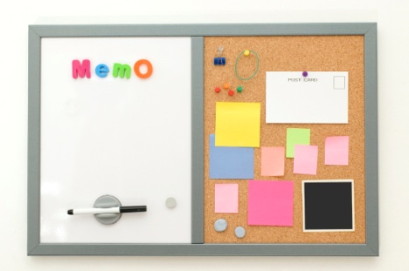
Work project 2.1
You are the owner of a very busy Bangkok restaurant. Business has been good and to reward your staff for their hard work, you are organising a party on 20 June 2012 at 8 pm. Please type up a memo to your staff advising them of the party and inviting them to bring their partner and/or family. You want to hold the party in your own apartment above the restaurant. For catering purposes, you need them to respond by 14 June.
Please ensure you:
Design a professional memo layout
Use correct memo spacing
Do a spell check and grammar check.
Save your memo on your USB under the new folder "Homework". Name it "Memo_20June2012".
Notes:
Trainer is to show trainees how to download a memo template (office button- new-memo template) as the basis of their assessment.
Trainer is then to:
read the work project to trainees.
set a due date for this project to be handed in
mark and return the projects to trainees.
This is work project 2 out of 5.
Remember to assess Part B of previous work project (oral presentation)

Slide 46

Rule of 7 Cs
Clear
Concise
Complete
Correct
Courteous
Clean
Checked.
Notes:
Rule of 7 Cs:
Clear - able to be understood in one reading by the recipient (time = money).
Concise - conveying what has to be stated with a minimum of words, sentences and paragraphs.
Complete - all of the information necessary to understand the correspondence is passed on.
Correct - all of the information conveyed is accurate.
Courteous - your tone is always polite as you are representing your organization and wish to create goodwill.
Clean - this means that there are no coffee stains, liquid paper, or crossing out on your correspondence. It also means that your work is not cluttered and there is plenty of white space so that the document looks appealing and professional.
Checked - this means your work has been examined for spelling mistakes, grammatical mistakes, format and layout and found to be mistake-free.

Slide 47
Class demonstration
Change page size and orientation
Change page margins
Add/delete columns
Formatting, including alignment and line spacing, font size, indents, font colours, outside borders, bullets, numbering
Copying, cutting and pasting
Inserting page breaks and section breaks
Inserting or changing headers and footers
Inserting page numbers
Contd.
Notes:
Trainer is to do a very comprehensive class demonstration showing students how to do the above.
Trainer is to give an exercise to the trainees so they can demonstrate competency.

Slide 48
Class demonstration (continued)
Adding styles
Inserting and formatting tables
Saving documents
Inserting images and graphics/clipart
Inserting smart art and shapes
Check spelling and grammar
Attaching documents
Saving and naming documents
Copying files/folders
Setting up the correct printer.
Notes:
Trainer is to do a very comprehensive class demonstration showing students how to do the above.
Trainer is to give an exercise to the trainees so they can demonstrate competency.
Holiday on the Mekong River – see next slides.

Slide 49

Holidays on the Mekong River
Background
The Mekong River is a great place to spend a few relaxing days and nights exploring one of the most scenic and legendary waterways in the world. It is the world's 10th longest river and the 7th longest in Asia. Its estimated length is 4,909 km and it drains an area of 795,000 km² (307,000 sq mi), discharging 475 km³ of water annually.
From the Tibetan Plateau this river runs through China, Burma, Laos, Thailand, Cambodia and Vietnam. The Mekong River Commission (MRC) was established in 1995 to assist in the management and coordinated use of the Mekong's resources. In 1996 China and Burma became "dialogue partners" of the MRC and the six countries now work together within a cooperative framework.
Accommodation
A wide range of accommodation alternatives are available:
Houseboats
Hotels
Motels
Small Bed and breakfasts.
To book a two day cruise on the Mekong River, please call us at Vietnam & Cambodia Trave on
tel (0084) 435 642 164 or visit http://www.vietnamdhtravel.com
Notes:
Display this class exercise on the whiteboard/projector. Trainees are to follow instructions on the following page. Trainer can print out copies of this class exercise for easier reference.

Slide 50

Class exercise instructions
Make the following changes and additions as listed below:
Format the heading to be Comic Sans 24 point size and centred. Use Box border and blue shading with white writing
Body copy to be Comic Sans 10 point size
Insert an appropriate graphic or photo
Carefully proofread the whole document, making any necessary spelling changes and paragraph changes
Bold and underline paragraph headings as shown
Indent the 3rd. paragraph as shown
Use double spacing throughout
Put in a hanging indent for the last sentence (to book....)
Centre the page vertically
Add a header with your name on the left and your group on the right, and a footer with the date on the left and page number on the right
Save the document as Mekong River on your USB.
Notes:
Students to complete the above exercise. Students should do this individually or in pairs depending on the number of computers available.

Slide 51
Work project 2.2
Type the attached letter on a page as it appears, noting the following instructions:
Use WordArt and Clipart to create the letterhead of the attached letter
The web address is in Ariel point 11 size, the remainder of the letter is in Ariel 12 point
The list is to be numbered and indented appropriately
Insert a footer with your name on the right
Save the document to your USB as Thai Eco Tours_name_date.
Notes:
Trainer is to
read the work project to trainees.
set a due date for this project to be handed in
mark and return the projects to trainees.
This is Workproject 3 out of 5

Slide 52

Thai Eco Tours
Notes:
Refer trainees to their manual to see sample.

Slide 53
Envelopes
Full name
Return address 1
Return address 2
Company name (if applicable)
Attn.: name/department
Recipient address 1
Recipient address 2
Postcode
To type an envelope in Microsoft Word, go to ‘mailings’ tab, ‘create envelope’, then enter the delivery address and return address details.
Notes:
Trainer to demonstrate how to type an envelope in Word.

Slide 54



Folding a standard letter
Unfolded First Fold Second Fold
Notes:
Show this chart to the trainees. Hand out A4 paper and ask them to fold according to these instructions:
1. Begin with the first page of the letter facing towards you.
2. Crease the letter along a fold one third from the bottom. Fold the letter up to a point one third from the top, covering the writing on the letter.
3. Make a second horizontal crease one third from the top of the letter where the bottom of the letter had been folded to.
4. Tuck the bottom into this crease and fold the top over it. The letter will be folded into thirds. It will fit any standard envelope.

Slide 55
Work project 2.3
You are the owner of a charter bus company, VLines, in 3345 Truong Street, Vientiane, Laos. Due to the recent global economic downturn, internal tourism numbers have dropped by 50%.
Write a memo advising all staff of an upcoming meeting to discuss repercussions of this downturn
Write a letter to your coach captains advising them of the meeting on July 1, 2012 at 2 pm in your office. Firstly consider the type of letter (routine letter, good news letter, bad news letter). Secondly, ensure you follow the correct steps. Explain why you have chosen this type of letter
Type out an envelope using the ‘mailings’ tab.
Spelling, grammar and sentence construction must be correct. Ensure that there is sufficient information in the document so that all the recipients understand what will be expected of them in terms of attendance.
Notes:
Trainer is to:
read the work project to trainees.
set a due date for this project to be handed in
mark and return the projects to trainees.
This is Workproject 4 out of 5

Slide 56
Element 2: SUMMARY
Any questions?
Notes:
Trainer to revise this element through the summary and provide a general class discussion.

Slide 57

Element 3: Maintain document systems
In this section, you will learn to…
File/store documents in accordance with enterprise procedures
Modify and/or update records management systems in accordance with enterprise procedures.
Notes:
At start of each element, trainer to explain the element in brief.

Slide 58
File/store documents in accordance with enterprise procedures
Alphabetical
Numerical
Geographical
By subject
By Key word
Chronological.
Notes:
Trainer to explain his/her own experience when filing according to industry guidelines.
Trainer to ask trainees their experience. “Did anyone ever have trouble finding files? Why?” OR “What did you like about the filing system in use and why?”
Trainer to link the above with the various filing techniques
Alphabetical
The most commonly used method of filing, the alphabetical system, places files in alphabetical order according to the customer or business name e.g. the telephone book.
Numerical
Each file or piece of information is filed in number order, from lowest to highest, according to the number on the document (for example, invoice number) or the customer number.
Geographical
Information is indexed alphabetically according to geographical location. States/Provinces are indexed first, followed by the city, town or suburb, then other appropriate information e.g. customer name.
Subject
Records are sorted according to the subject matter and filed alphabetically. This allows information on the one topic, or subject, to be easily located.
Key word
A particular word is used as the subject classification and specific descriptors are also allocated to further classify the information. Keyword systems are usually used in large organisations where the keywords are specifically designated.
Chronological
Chronological filing is used in conjunction with other filing methods and involves sorting records according to their date.

Slide 59
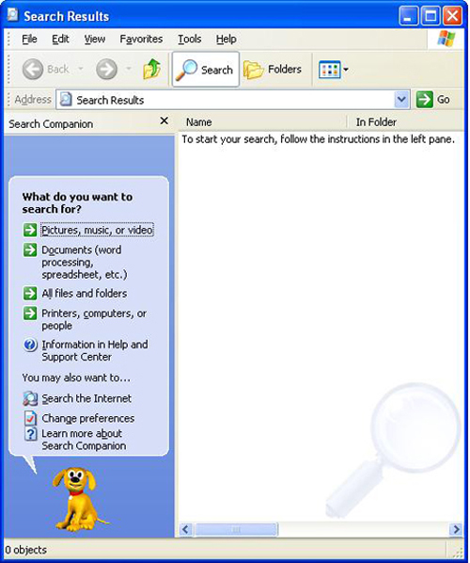
How to retrieve a document
Windows Explorer
Go to Computer icon on your desktop OR go to “Start”
“Search”
“All files and folders”
Fill in the information that is known, as shown below.
Notes:
Trainer to do a class demonstration on document retrieval.

Slide 60
Deleting temporary files
Locations:
C:\Temp
C:\Windows\Temp
C:\Windows\Temporay internet files.
Steps:
Click on a file on the right of the screen and press Ctrl A (select all)
Click on the delete button or press the Delete key, and click on Yes. If you receive any further messages about files, click on No.
Notes:
Trainer to do a class demonstration on how to delete all files. Students to do this on their computer.

Slide 61

Emptying recycling bin
Double click on the Recycle Bin icon
Choose [File] Empty Recycle Bin, then click on Yes
Close the Recycle Bin.
Notes:
Trainer to do a class demonstration on emptying the recycling bin. Students to follow.

Slide 62
If computer freezes
Are all the leads connected properly? Check monitor lead, mouse connection, hard drive connections.
Don’t keep clicking
Don’t hit it
Do wait for a few moments to see if it catches up with your flying fingers
If not – then hit Alt+Ctrl+Del. or the restart button (but only as a last resort).
Notes:
REMIND – trainees to always save everything on a regular basis.

Slide 63
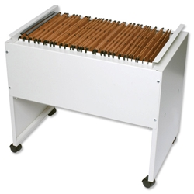

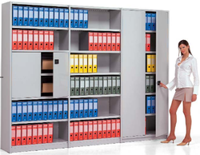
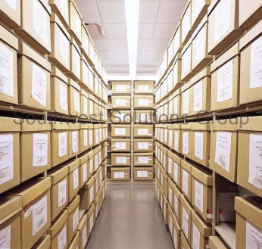
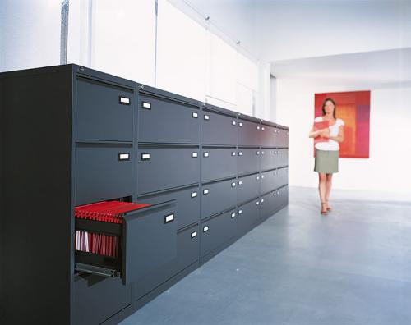
Paper based storage
Filing cabinets
Flat boxes
Lever arches
Suspension folders
Shelving
Lateral cabinets, compactus
Other: trolley, spike file, rotary file, concertina file.
Notes:
Trainer to explain own experience with these and advantages/disadvantages he or she experienced.
Ask trainees what they have used to date in the workplace.

Slide 64


Electronic storage
Database management systems:
Microsoft Access
Filemaker
Microsoft SQL Server
MySQL
Oracle
Computer files
Email.
Notes:
Trainer to explain own experience with these and advantages/disadvantages he/she experienced.
Ask trainees what they have used to date in the workplace.
Explain that Access has templates for database management. Print-outs of reports.

Slide 65

Work project 3.1-3.2
Save all work projects in a newly created folder “Work projects”. Label them according to their number ie work project 1.1-1.3, work project 2.1, work project 2.2, work project 2.3, work project 3.1-3.2
Save all answers to the written questions in a newly created folder “Answers_first name_last name”. File them as per the filing techniques in element 3.2 and explain why you have chosen this style of filing
Compose a new message to your trainer, using Outlook Express and attach both folders.
Notes:
Trainer is to:
read the work project to trainees.
set a due date for this project to be handed in
mark and return the projects to trainees.
This is work project 5 out of 5

Slide 66

Element 3: SUMMARY
Any questions?
Notes:
Trainer to revise this element through the summary and provide a general class discussion.

